Slide 1

DATA ANALYSIS USING POWERBI

Slide 2

BUSINESS OBJECTIVE
The primary objective is to analyze Airbnb data to reveal insights into user experiences and satisfaction levels with the numerous listed stays, all accomplished using Power BI.

Slide 3


DATA USED FOR ANALYSIS
AIRBNB LISTINGS
AIRBNB REVIEWS

Slide 4
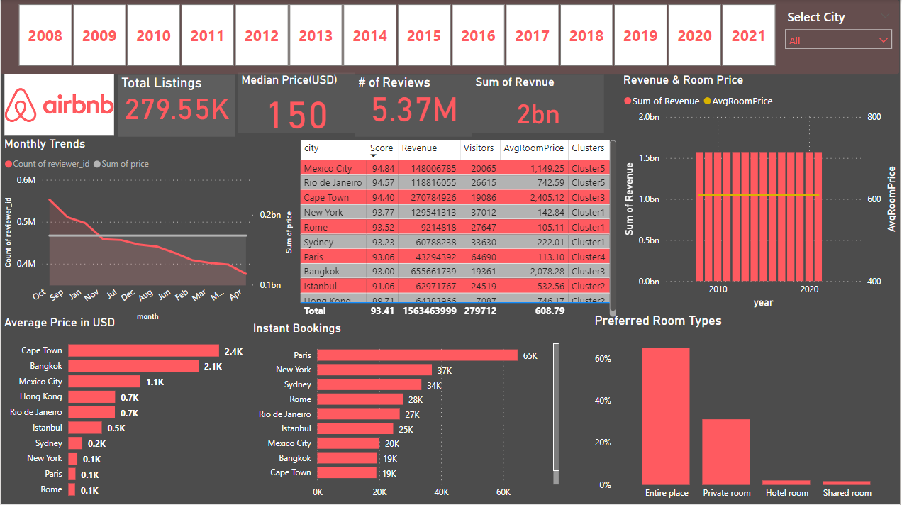
DASHBOARD OVERVIEW

Slide 5
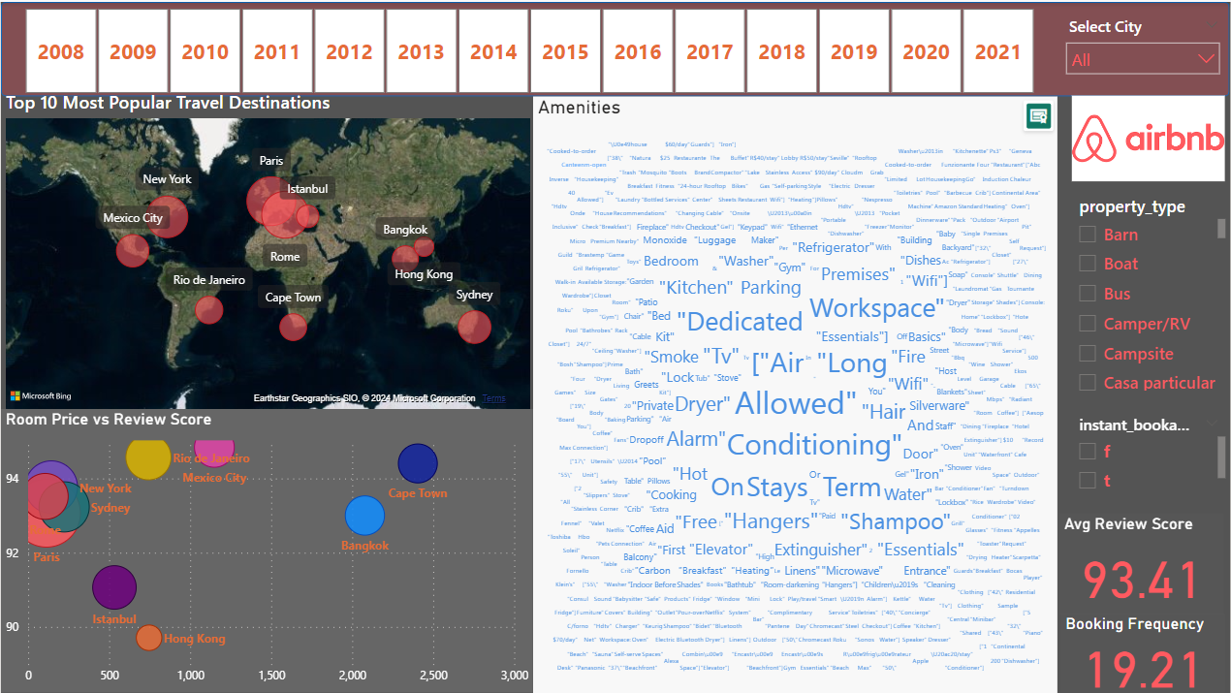

Slide 6
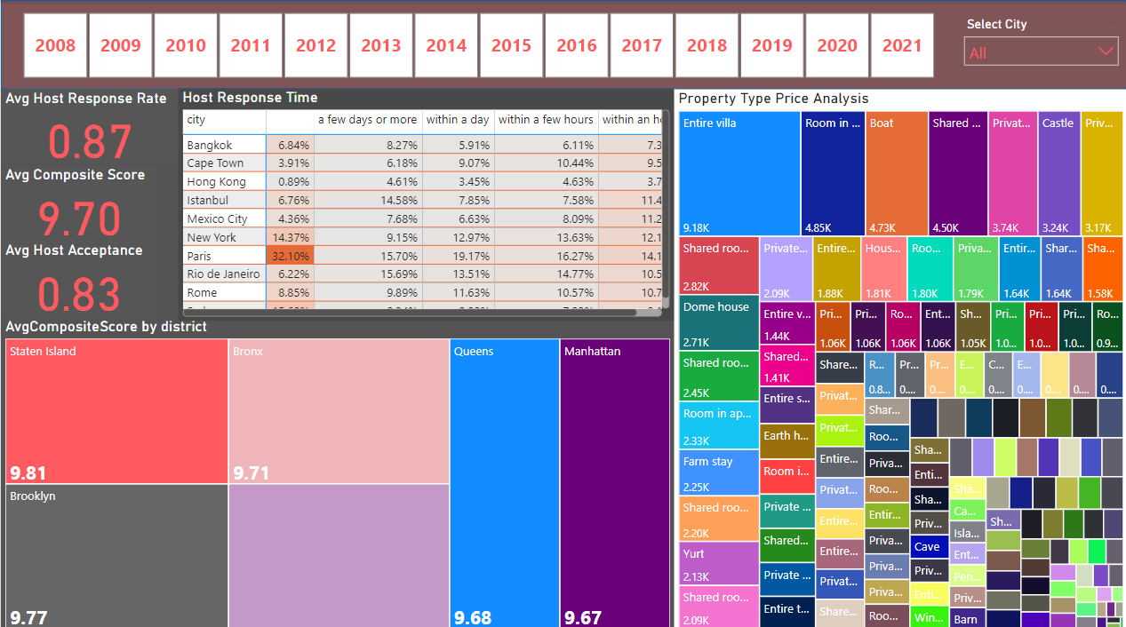

Slide 7

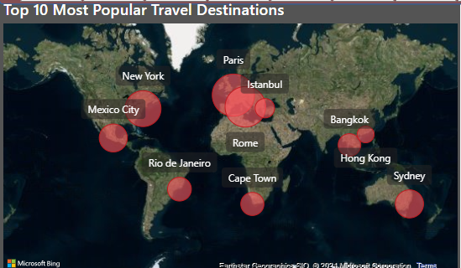
Now that we have seen Overview of Airbnb Dashboard, Lets dive into specific project goals and how they are analysed by using charts, graphs and usage of DAX FUNCTIONS, CUSTOM COLUMNS from the existing data.
This chart is created based on DAX FUNCTIONS called POPULARITY SCORE, BOOKING FREQUENCY, AVGREVIEW SCORE, REVIEWCOUNT
PopularityScore=(Reviews[ReviewCount]*0.4)+([AvgReviewScore]*0.4)+([BookingFrequency]*0.2)

Slide 8
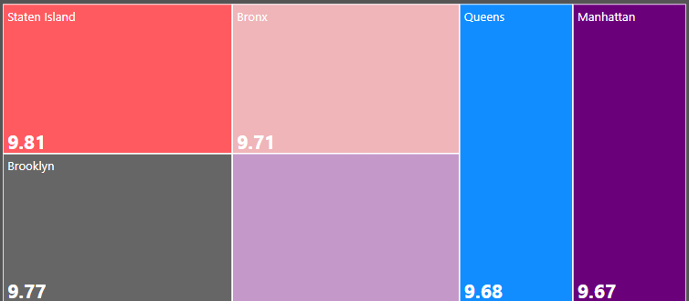
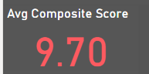
Analysing Composite Scores: Created a Composite Score column that integrates check-in experience and host communication for various districts with subsequent analysis and insights
CompositeScore=(0.5*Listings[review_scores_checkin]+0.5*Listings[review_scores_communication])/1

Slide 9
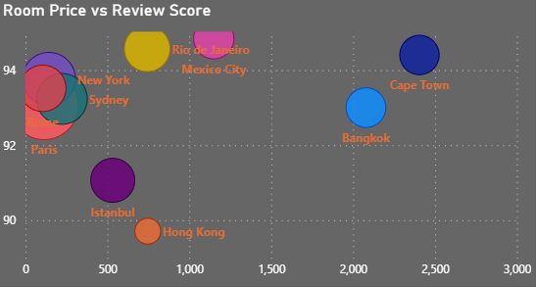
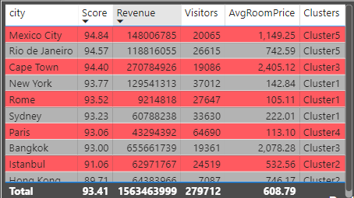
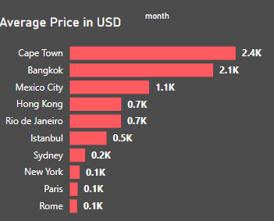
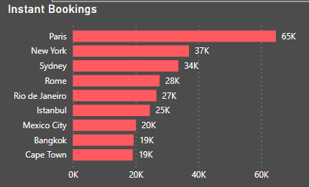
Crafting a comprehensive City Insights Report , Examining host response time impact and Visualizing Airbnb Listing Prices
DAX FUNCTIONS USED::
AvgRoomPrice
Visitors
Clusters AvgPrice
AvgRevScore

Slide 10
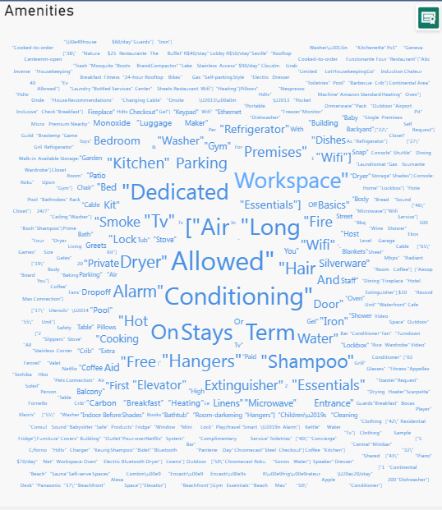
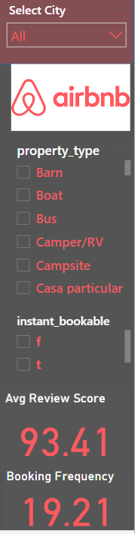
Analysing Amenities of Airbnb Listings based on Property type and City using WORDCLOUD IN POWERBI

Slide 11

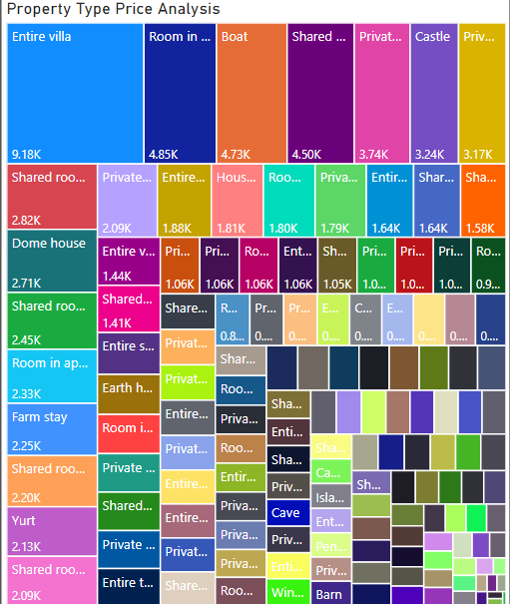
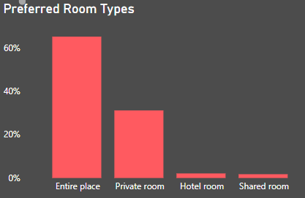
Property Type Price Analysis along with Preferred Room Type Analysis

Slide 12
KEY INSIGHTS
Mexico is one of the most loved cities by Airbnb users with more than 11,520 listings and generate $52M revenue.
High demand for travel rises up prices more in October before the year end rush in December and January. Prices and demand drop dramatically in April-May, during most school terms.
Strong Revenue growth from 2013-2016 from $6M to $150M. Revenue decreased to $65M due to COVID19.
Sundays bring an exponential increase in visitors.

Slide 13
Increase in no.of listings in Airbnb is seen in peak in 2015. Paris contributes to highest no of listings.
Mexico city has the highest average review score with 94.84 compared to Hong-Kong which has the lowest score with 89.7.
Paris is the most visited city with highest listings but has low score in cleanliness and values.
Most important features affecting overall scores in amenities are Wifi, the essentials, long term stays allowed and the kitchen. Depending on the country, Airbnb users expect heating and air-conditioning.

Slide 14

Sharing the gift of Travel---THANK YOU FOR HOSTING AIRBNB

